Slide 1
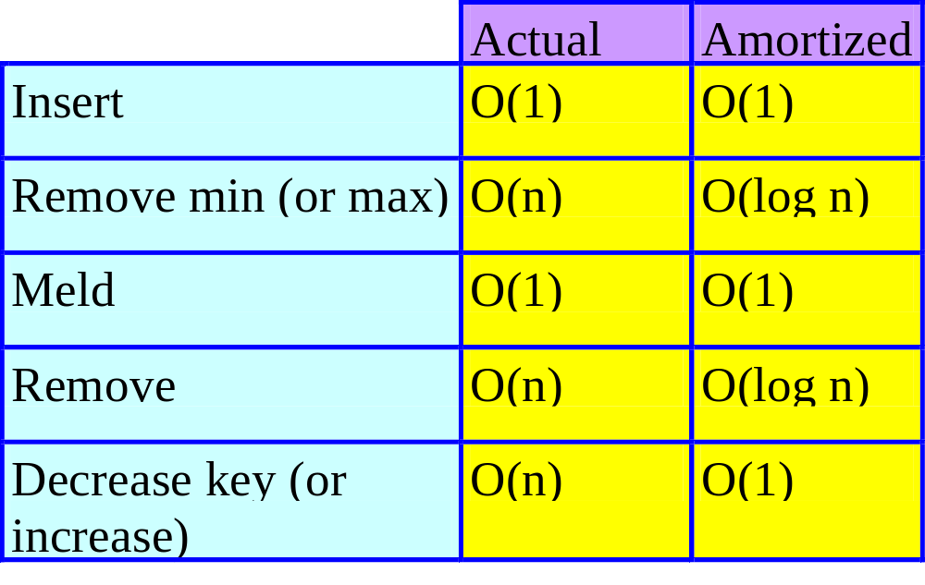
Fibonacci Heaps
Notes:
Remove arbitrary is useful in (for example) correspondence structures and may also be used to do an increase key in a min structure (remove and reinsert). General simulation environment: increase/decrease priority after entry, item departs without service (arbitrary remove), meld 2 queues because 1 server dies.

Slide 2
Analysis
FibonacciAnalysis.ppt
Video
  www.cise.ufl.edu/~sahni/cop5536; Internet Lectures; not registered
  COP5536_FHA.rm

Slide 3
Single Source All Destinations Shortest Paths
8
6
2
1
3
3
16
1
6
7
4
5
10
4
2
4
7
5
3
14

Slide 4
Greedy Single Source All Destinations
Known as Dijkstra’s algorithm.
Let d(i) be the length of a shortest one edge extension of an already generated shortest path, the one edge extension ends at vertex i.
The next shortest path is to an as yet unreached vertex for which the d() value is least.
After the next shortest path is generated, some d() values are updated (decreased).

Slide 5
Greedy Single Source All Destinations
8
6
2
1
3
3
16
1
6
7
4
5
10
4
2
4
7
5
3
14
Path
Length
6
1
2
1
0
1
3
5
4
9
1
3
2
1
3
6
10
1
3
5
5
1
3
6
7
11

Slide 6
Operations On d()
Remove min.
  Done O(n) times, where n is the number of vertices in the graph.
Decrease d().
  Done O(e) times, where e is the number of edges in the graph.
Array.
  O(n²) overall complexity.
Min heap.
  O(nlog n + elog n) overall complexity.
Fibonacci heap.
  O(nlog n + e) overall complexity.
Notes:
Initialize is done once and takes O(n) for all 3 structures.

Slide 7
Prim’s Min-Cost Spanning Tree Algorithm
Array.
  O(n²) overall complexity.
Min heap.
  O(nlog n + elog n) overall complexity.
Fibonacci heap.
  O(nlog n + e) overall complexity.
Notes:
Start with any vertex; this is a tree T with 1 vertex and no edge
In each round add a least cost edge with one vertex in T and the other not in T
Continue until all n vertices are in T or no next edge available to add

Slide 8
Min Fibonacci Heap
Collection of min trees.
The min trees need not be Binomial trees.

Slide 9
Node Structure
Degree, Child, Data
Left and Right Sibling
  Used for circular doubly linked list of siblings.
Parent
  Pointer to parent node.
ChildCut
  True if node has lost a child since it became a child of its current parent.
  Set to false by remove min, which is the only operation that makes one node a child of another.
  Undefined for a root node.
Notes:
Doubly linked list … remove arbitrary uses external pointers to nodes and also requires deletion of a tree from its doubly linked circular list. So, we cannot copy an element from the next node as is done in the delete of an arbitrary node from a singularly linked circular list. Further, there is a parent pointer to a node. If you move an
element you must change the parent pointer from its children. This would take O(children) time.
Parent field needed for decreaseKey and cascading cut as well. Decrease key also needs external pointers to nodes in the heap. Arb delete and decrease key may cause a node to lose a child.

Slide 10
Fibonacci Heap Representation
A
2
1
4
4
5
9
7
3
6
7
6
8
5
5
8
6
9
9
Degree, Parent and ChildCut fields not shown.
Notes:
Try to remove 4 from the purple tree. If you copy the 5 over, there is an external pointer to 5’s former node
And also a parent pointer from 6 to 5.

Slide 11
Remove(theNode)
theNode points to the Fibonacci heap node that contains the element that is to be removed.
theNode points to min element => do a remove min.
  In this case, complexity is the same as that for remove min.

Slide 12
Remove(theNode)
theNode points to an element other than the min element.
  Remove theNode from its doubly linked sibling list.
  Change parent’s child pointer if necessary.
  Set parent field of theNode’s children to null.
  Combine top-level list and children list of theNode; do not pairwise combine equal degree trees.
  Free theNode.
In this case, actual complexity is O(#children of theNode).
Notes:
Parent’s child pointer may become null. But actual complexity becomes O(n) once you factor in cascading cut. You could do pairwise combining of equal degree trees but this is not needed to obtain the amortized complexity.

Slide 13
Remove(theNode)
1
6
5
theNode
4
7
3
9
2
4
9
10
5
8
5
6
7
9
6
8
Remove theNode from its doubly linked sibling list.

Slide 14
Remove(theNode)
1
6
5
7
3
9
2
4
9
8
5
4
6
7
6
10
5
8
9
Combine top-level list and children of theNode setting parent pointers of the children of theNode to null.
Notes:
Must make parent pointers in theNode’s children equal to null.

Slide 15
Remove(theNode)
10
5
1
6
5
9
7
3
9
2
4
9
8
5
6
7
6
8
Notes:
No pairwise combining of equal-degree trees. Child pointer from parent (if any) needs to be changed.
Heap pointer is unchanged. Parent pointers of theNode’s children need to be set to null. Actual complexity is degree of theNode.
With cascading cut added, actual complexity becomes O(n).

Slide 16
DecreaseKey(theNode, theAmount)
1
6
5
theNode
4
7
3
9
2
4
9
10
5
8
5
6
7
9
6
If theNode is not a root and new key < parent key, remove subtree rooted at theNode from its doubly linked sibling list.
Insert into top-level list.
8
Notes:
DecreaseKey(theNode,4). Possible update of min element pointer. Parent pointer set to null and child pointer from parent may need to be reset. Actual complexity is O(1). But becomes O(n) when cascading cut is factored in. You could do pairwise combining of equal degree nodes, but this would make amortized complexity O(log n) rather than O(1).

Slide 17
DecreaseKey(theNode, theAmount)
0
1
6
5
10
5
7
3
9
2
9
8
4
5
9
6
7
6
8
Update heap pointer if necessary

Slide 18
Cascading Cut
When theNode is cut out of its sibling list in a remove or decrease key operation, follow path from parent of theNode to the root.
Encountered nodes (other than root) with ChildCut = true are cut from their sibling lists and inserted into top-level list.
Stop at first node with ChildCut = false.
For this node, set ChildCut = true.

Slide 19
Cascading Cut Example
1
7
3
2
F
8
4
T
5
9
6
T
7
6
8
theNode
9
8
Decrease key by 2.
9

Slide 20
Cascading Cut Example
1
6
7
3
2
F
9
8
8
4
T
5
9
9
6
T
7
6

Slide 21
Cascading Cut Example
1
6
7
7
3
2
F
9
8
8
4
T
5
9
9
6
6

Slide 22
Cascading Cut Example
1
6
7
4
7
3
2
F
9
8
6
8
5
9
9
6

Slide 23
Cascading Cut Example
1
6
7
4
7
3
2
T
9
8
6
8
5
9
9
6
Actual complexity of cascading cut is O(h) = O(n).
Notes:
Actual complexity of cascading cut is O(n), because now the tree height may be O(n).
Do ops to create a B2 (height = 3). Now do a decrease key to get a chain
of height (length) 3 and a B0. Do 2 inserts, a remove min, and a decrease key to get a chain of height 4 and B0. We can increase height by 1 each time we do 2 inserts, a remove min, and a decrease key. So, height is O(n), where n is number of operations (or number of elements in tree).

